Slide 1


NEXIOT MINDS SINUSSYNC
TEAM MEMBERS:
V.MANASA
V.SREEJA
V.POOJITHA
T.MALLESWARI
R.PUJITHA

Slide 2
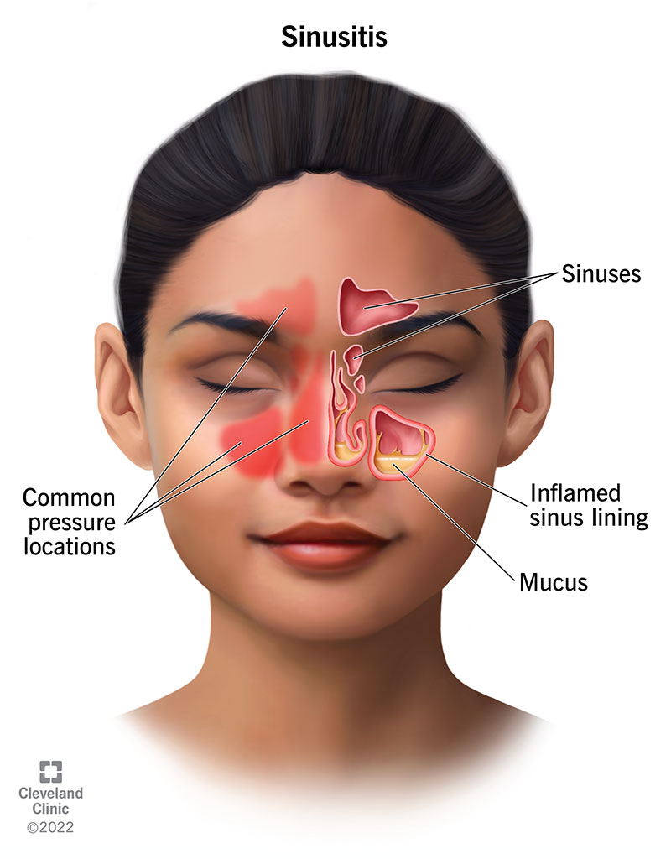
INTRODUCTION
Sinusitis is an inflammation of the
sinus cavities.
As this is the common medical condition
caused by infections , allergies , or structural
issues.
As our project focuses on collecting data
from the nasal passages of patients to understand
the underlying causes and symptoms of sinusitis.

Slide 3
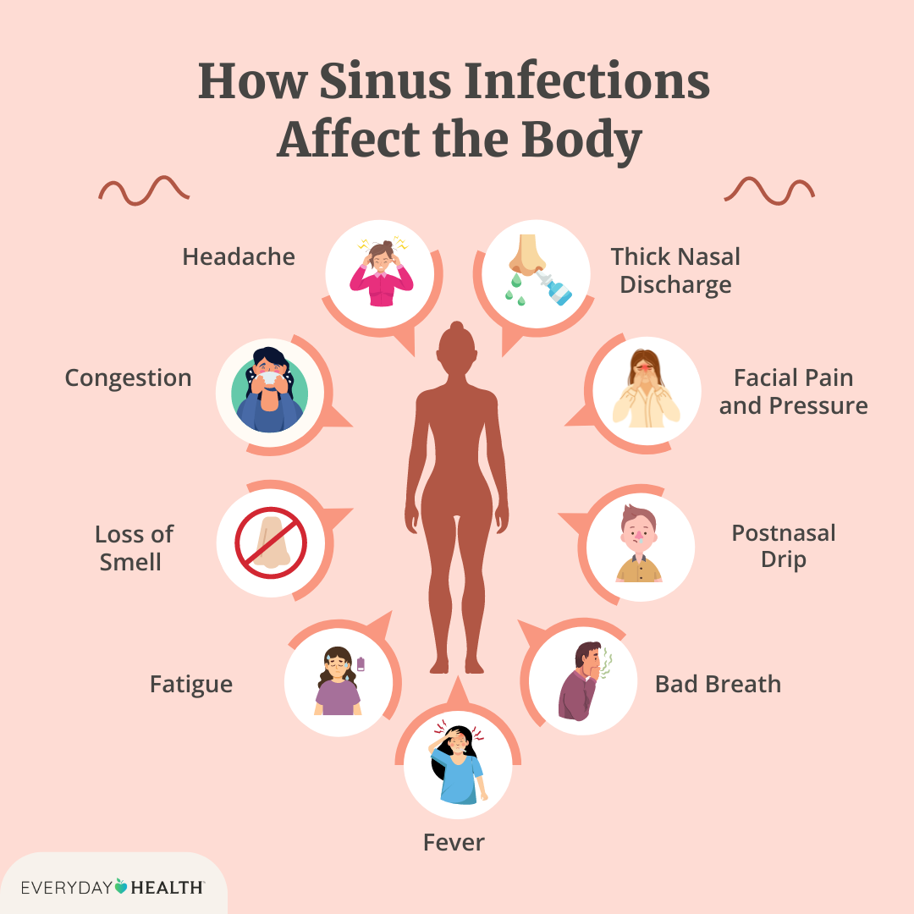
PROBLEM STATEMENT
Due to an inaccurate diagnosis due to
the similarity of symptoms with other
respiratory conditions like common
cold or allergies.
Many patients are suffering from chronic
sinusitis without understanding the
underlying cause.
The specific triggers of sinusitis , whether
they are envinormental , structural , or
microbial are not always well-documented.

Slide 4
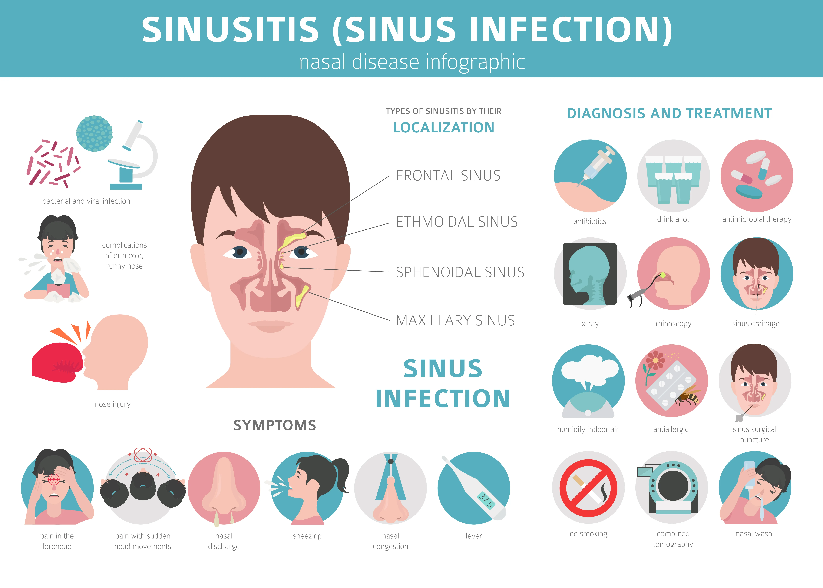
EXISTING SOLUTIONS
Over the counter(OTC) Medications.
Nasal Irrigation (saline rinses).
Prescription Medications.
Endoscopic Sinus Surgery.
Ballon Sinuplasty.
Allergy Management.
Lifestyle changes and Home Remedies.
Imaging and Diagnostic Tools.

Slide 5
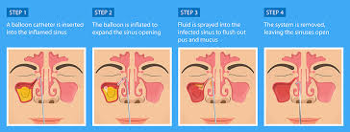
PROPOSED SOLUTION
The proposed statements focus on how the project can ease and improve the doctor-patient interaction by using continuous data collection for sinusitis patients.
So our project is very helpful for this kind of patients to collect there data and check them before becoming it into serious condition.

Slide 6
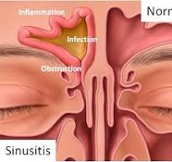
VALUE PROPOSITION
As we, collect data on nasal pressure , and humidity from the patient’s nasal passages.
Patients monitor their data and when they visit doctor they can show that.
Feedback is given back to the patient through doctor consultation.

Slide 7
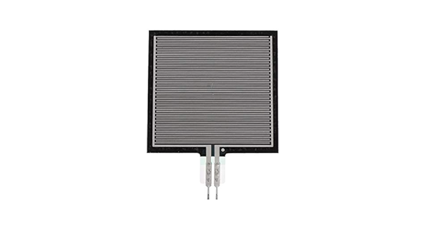
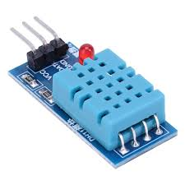
SENSORS
In this project we have been using the
pressure sensors that which us to
collect the real time data by these day
to day.
In this we used another sensor also that
humidity and temperature sensors that help
to collect the data according to the climate
changes.

Slide 8
ARCHITECTURE
.
ESP32
DHT11
PRESSURE
SENSOR
DHT11
PRESSURE
SENSOR
ESP32
CLOUD
BLYNK
CLOUD
CLOUD
DATA COLLECTION
MODEL
ABNORMAL
VALUES
DATA ANALYSIS
NOTIFICATION
TO THE
USER

Slide 9
CONCLUSION
In conclusion , this project presents a novel approach to managing sinusitis by integrating advanced data collection through pressure , temperature , and humidity sensors.
By continuously gathering real-time data from patients, the system provides a more accurate and comprehensive understanding of sinus health , enabling both patients and healthcare providers to monitor symptoms more effectively.
The collected data is securely stored and analyzed , offering insights that lead to personalized treatments and timely interventions.
===THE END===

